Slide 1



Website Presentation
Reporting time:2023.9.24 Group:17

Slide 2

Content
01
Group Introduction
02
Target audience
03
Client expectations
04
Design ideas

Slide 3

01
Group Introduction
There are five team members who have different division of labor, and we cooperate with each other to complete the task together.

Slide 4





Team members
The division of labor for each of us
DesignGuru
Meixian Shi
TextMaster
Ruoyu Li
Design of page layout
writing for the Web
2
4
1
3
5
Fearlessleader
Yumeng Zhang
DesignGuru
Xiaotong Chen
PixelMeister
Yiran Hou
Lead and control the team
Design of page layout
color and graphics on a Website

Slide 5
02
Target Audience
A deep understanding of the target audience can help us determine the service content of the website based on their preferences

Slide 6
Description
A comprehensive description of the target audience
FOUR ASPECTS
Our primary target audience consists of young entrepreneurs and business owners, ranging in age from 25 to 45 years old. We aim to cater to individuals within this age bracket who are seeking to establish or grow their businesses.
Our platform aims to engage and attract both male and female entrerprisers. We strive for gender equality and greet business owners from all backgrounds and perspectives.
1、Most are middle class, self-employed or small business owners.
2、The average household earns between $50,000 and $150,000 a year. 3Some clients may be founders of start-ups with lower revenues but potential growth.
1、Strong interest in finance, seeking deeper understanding.
2、Basic grasp of tax rules and accounting, need professional guidance.
3、Seeking financial management and tax planning solutions to optimize operations.
4、Focus on time-saving and reducing tax burden.
Age
Gender
Interest
social economic criteria

Slide 7
Deeper understanding
The target audience usually does not have in-depth accounting knowledge, so the website should provide financial education materials that are easy to understand.
Financial explanation
Target audiences want professional accounting and tax services to ensure compliance and maximize financial efficiency. Site owners need to provide high quality accounting reports, tax returns to meet customer requirements.
Professional accounting and tax services
WEB
The web site can provide online consultation and appointment function to meet the personalized needs of customers to solve their specific business and financial challenges.
Personalized counseling

Slide 8
03
Client expectations
Meeting customer expectations is critical for successful web design and online businesses. We approach this by analyzing customer expectations from three key perspectives.

Slide 9

Overview
Three Aspects
THE FRIST
A clear and concise design
THE SECOND
Effectively meeting customers' specific needs and preferences.
THE THIRD
Various design elements make a professional modern look

Slide 10

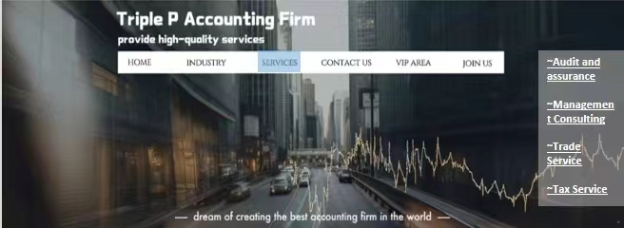
The First : Clear Design
1、Clear navigation
2、Convenient anchor points
Our clients expect a website with a clear and user-friendly design, enabling them to effortlessly navigate and swiftly locate the desired information. This ensures a seamless user experience, enhancing overall satisfaction.

Slide 11
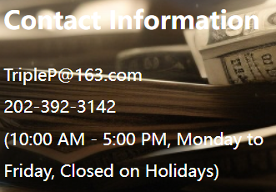
The Second : Meet customer needs
CONTACT INFORMATION
Therefore it may be the case that issues arise, i.e. issues with national postal services, international customs issues etc.
CONTACT
INFORMATION
SEVICE INFORMATION
As a web site specializing in small business and tax accounting, provides accurate service information to meet the diverse needs of customers.
The homepage showcases the company culture and future corporate plans to enhance the credibility of the webpage
SEVICE
INFORMATION

Slide 12

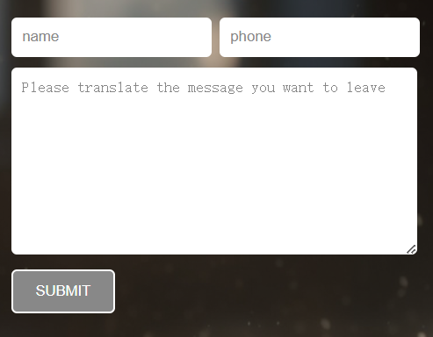
The Second : Our Services & Solutions
INTEGRATE SOCIAL MEDIA
INTERACTIVE
ELEMENTS
Integrating social media into your site makes it easy for users to share content and interact with your brand on different platforms
Interactive elements, such as forms, surveys, comment areas, and social media sharing buttons, promote user engagement and increase user interaction.
INTEGRATE SOCIAL MEDIA
INTERACTIVE
ELEMENTS

Slide 13
The Third : Overview Design Elements
Design Element
ANIMATION AND TRANSITION EFFECTS
Design Element
VISUALLY APPEALING PICTURES AND GRAHICS
VIDEO CONTENT
HARMONIOUS COLOR MATCHING
CUSTOMER AESTHETIC
lOGO AND LOGO DESIGN
CLEAR TYPOGRAPHY AND FONT SELECTION
CONSISTENT STYLE
HIGH QUALITY CONTENT
Design Element
Design Element

Slide 14
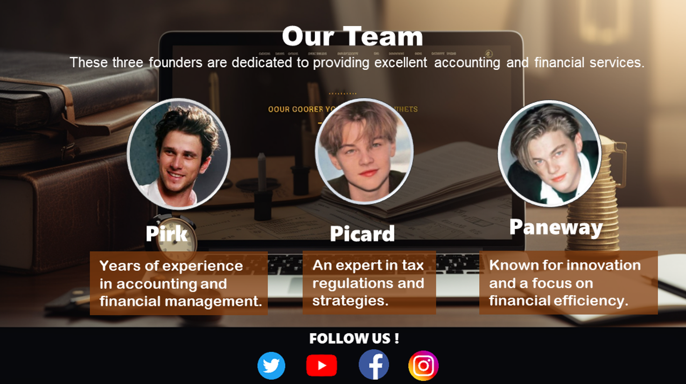
The Third : Specific explanation
Consistent style : The consistent style increases the recognition of our brand.
Harmonious color matching: The design of black gold adds professionalism and a sense of design.
Clear typography and Font selection : Headings, paragraph spacing, bullet points, and numbering to make typography clearer.
High quality of content & pictures :Carefully selected content to customers reflects our professionalism

Slide 15

The Third : Specific explanation
ANIMATION AND TRANSITION EFFECTS
VIDEO CONTENT
LOGO DESIGN
The web page provides company and product introduction videos to provide more information and attract customers&#039; attention
The homepage uses animations and transitions to add movement and modernity to the site

Slide 16
04
Design ideas
• Sample Page Layout
• Layout Format
• Color Scheme
• Fonts
• Graphics
• Content
• Page Design Ideas

Slide 17
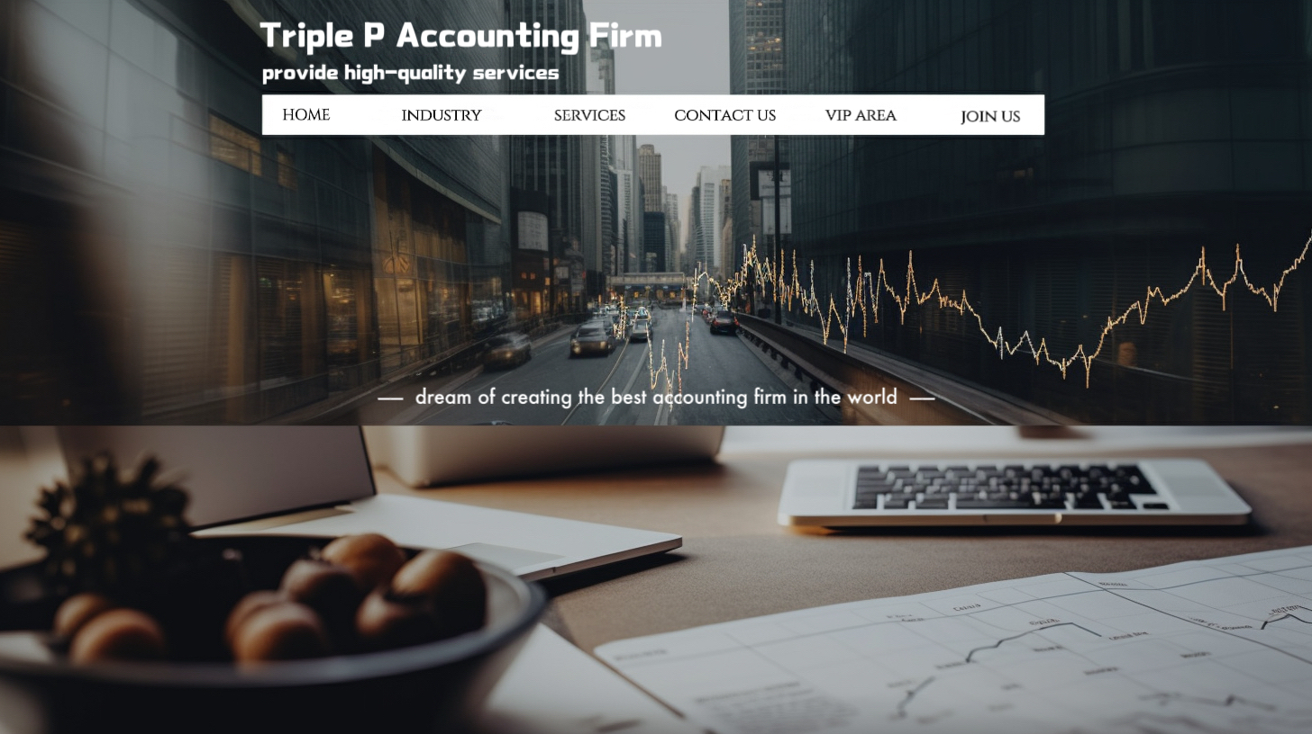
• Sample page layout

Slide 18


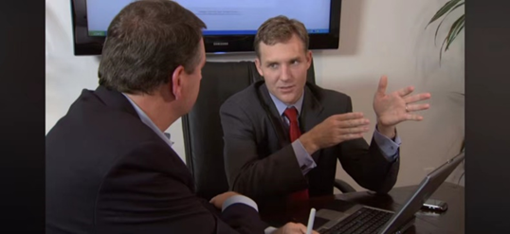


Company Introduction
Triple P accounting firm is a burgeoning company dedicated to providing professional, reliable, and comprehensive accounting solutions. Our mission is to assist individuals, small and medium-sized enterprises, and entrepreneurs in managing their finances, allowing them to focus on business development with confidence in entrusting their financial work to us, we have the capability to offer tailored accounting and financial services to meet your unique needs.
know more about us

Slide 19








Our Team
These three founders are dedicated to providing excellent accounting and financial services.
Pirk
Picard
Paneway
Years of experience in accounting and financial management.
An expert in tax regulations and strategies.
Known for innovation and a focus on financial efficiency.
FOLLOW US !
19

Slide 20






Enterprise Culture
Our Mission
Our Purpose
Our Guideline
Our Vision
Our mission is to provide exceptional accounting services to small businesses and empower their financial success through perfect tax accounting support.
Our purpose is to simplify financial management for small businesses by providing them with clear and practical solutions.
Our guideline is to prioritize interests of clients and uphold the values of integrity, precision, and efficiency.
Our vision is to create lasting value for our clients through outstanding service and innovative solutions.
20

Slide 21





Future Development Timeline
Develop
Growth and consolidation
Leading
Innovation and sustainable
2
4
1
3
Start
Establishing a foundation
Accelerate
Expansion and absorption
21

Slide 22
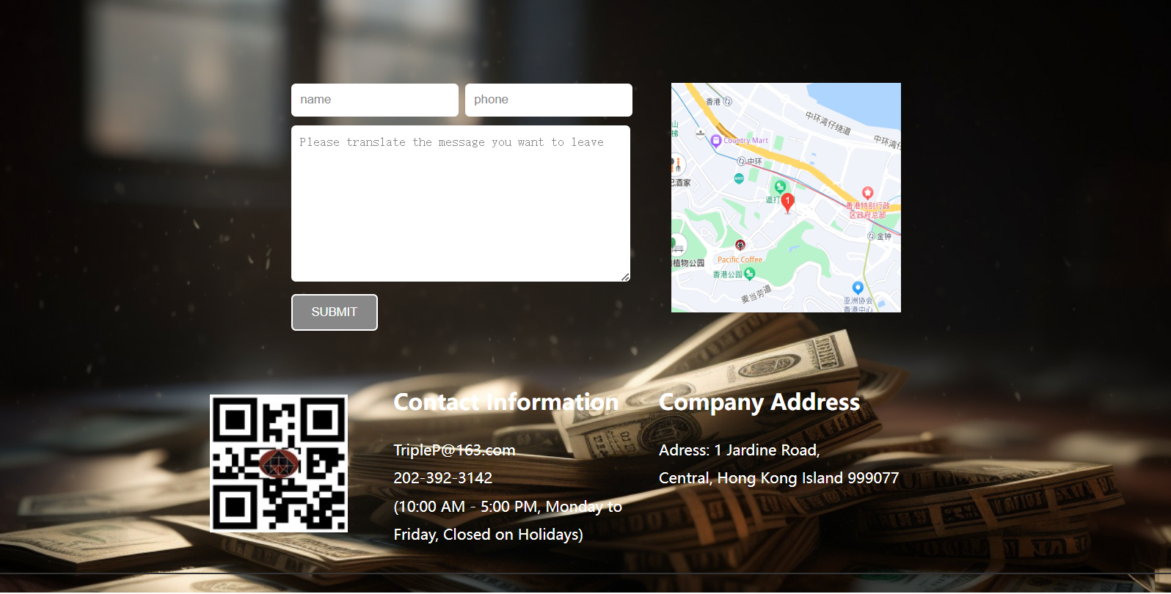

Slide 23
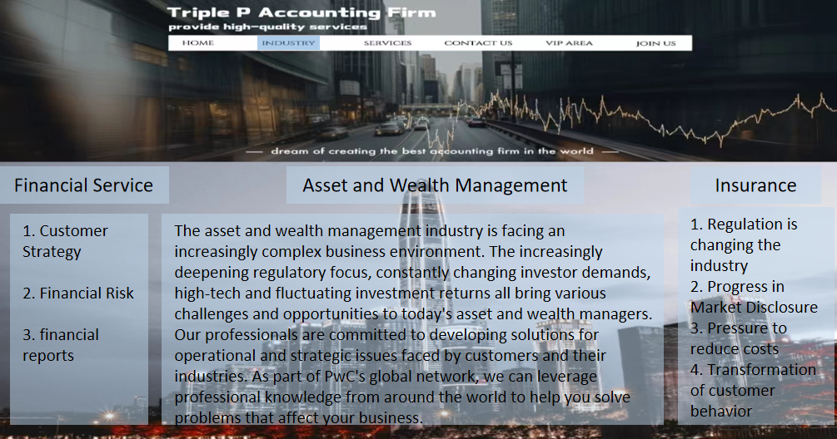

Slide 24
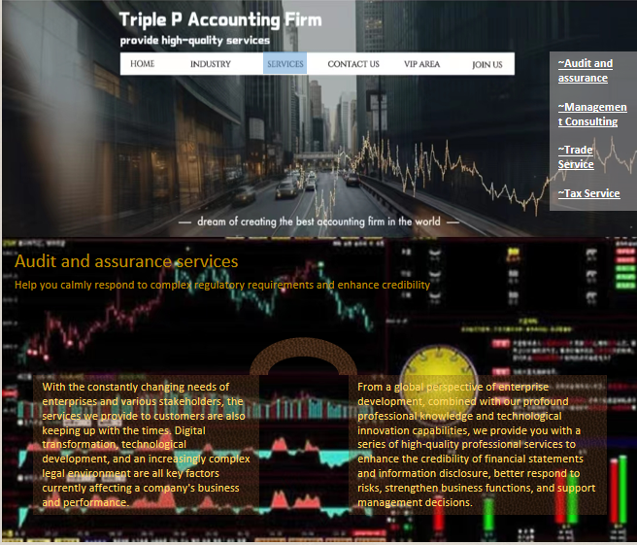

Slide 25
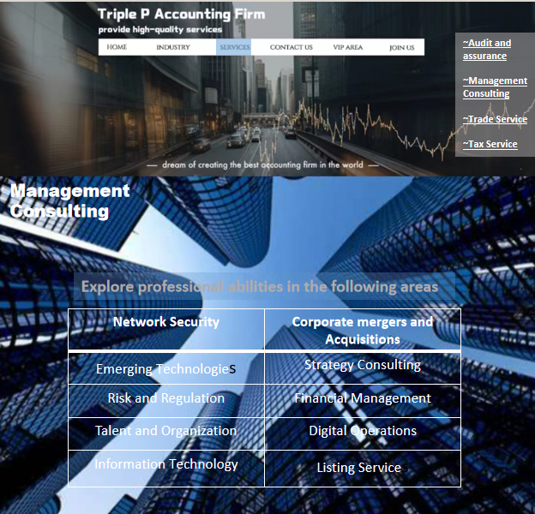

Slide 26


Slide 27
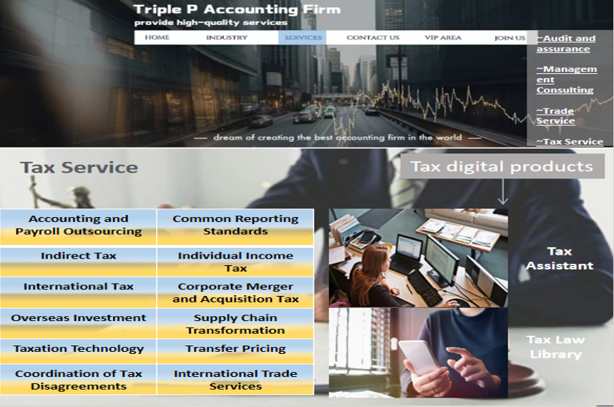

Slide 28
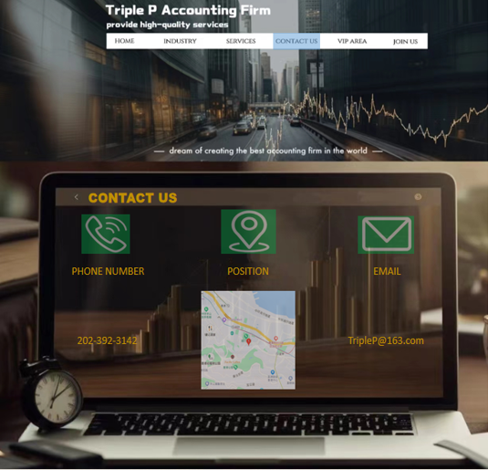

Slide 29
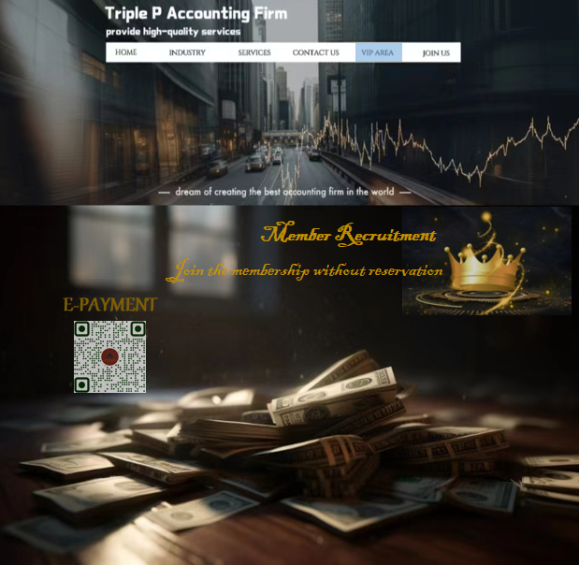

Slide 30
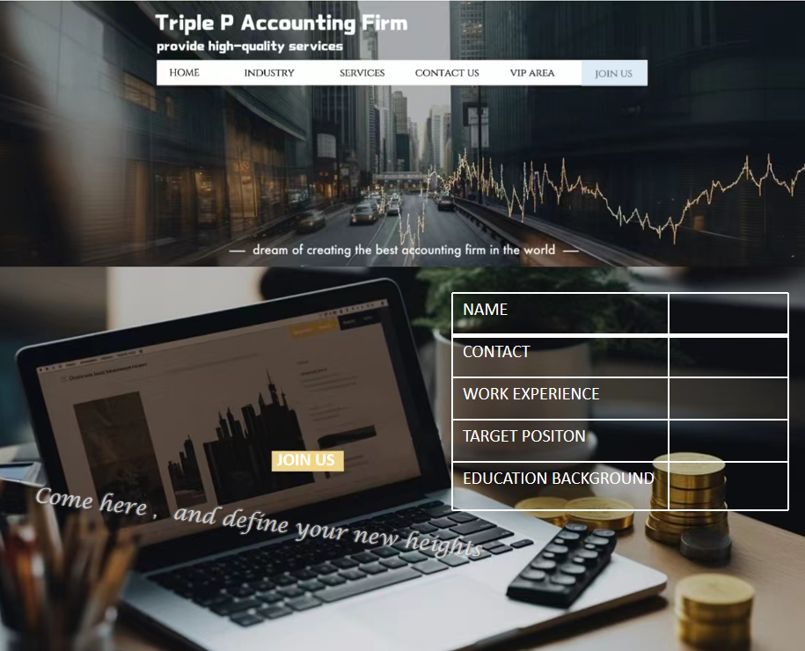

Slide 31

• Layout Format
1.Responsive Design: Fluid layout is the cornerstone of responsive web design, allowing web pages to adapt seamlessly to various screen sizes
2. Flexible Grid Systems: Fluid layouts employ flexible grid systems, where element widths are defined in percentages rather than fixed pixels.
3. Enhanced Accessibility: Fluid layouts enhance website accessibility by making content more readable and navigable for users with visual impairments and those using assistive technologies.
4. Cross-Browser Compatibility: Fluid layouts help maintain consistency across different web browsers. Whether users are using Chrome, Firefox, Safari, or Edge, the web page will display correctly.
Flow Layout

Slide 32
• Font
1
2
3
Arial Rounded MT Bold
Arial
Arial Black
Main uses：
• title
• subtitle
Main uses：
• text
• small Text
Main uses：
• text
• small Text
Characteristic：
• bold style
• highlight text and information • capture attention
• make the text more prominent
Characteristic：
• rounded
• friendly letterforms • soft
• convey relaxed feeling
Characteristic：
• modern
• clean • easy to read
• concise

Slide 33
• Color Scheme
#1F4E79
#7F6000
Over 50
#0070C0
Harmony in Tone
#A8A9AD
#1F4E79
Importance
• enhance the usability and user-friendliness
• visually appealing
• conveys professionalism and credibility.
#9C5616
#BF9000
#000000
• vibrant of colors
• specific color combinations
#881512
#A44E0E
#BF9000
#C55A11

Slide 34
*{
margin:0;
padding:0;
}
html,body{ height:100%;
}
·the first picture width:100%
height:40%;
background-repeat:no-repeat;
background-size:cover;
·the second picture
width:100%
height:60%;
background-repeat:no-repeat;
background-size:cover;
• Graphic
Look at this page, for example, we’ll analyze the layout of the pictures. There are 2 pictures in this page.

Slide 35

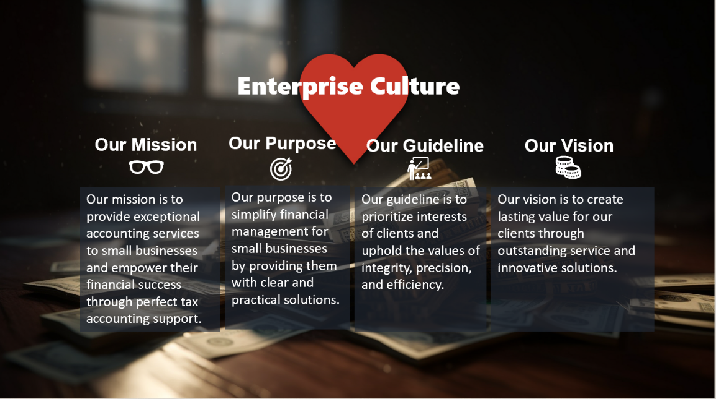
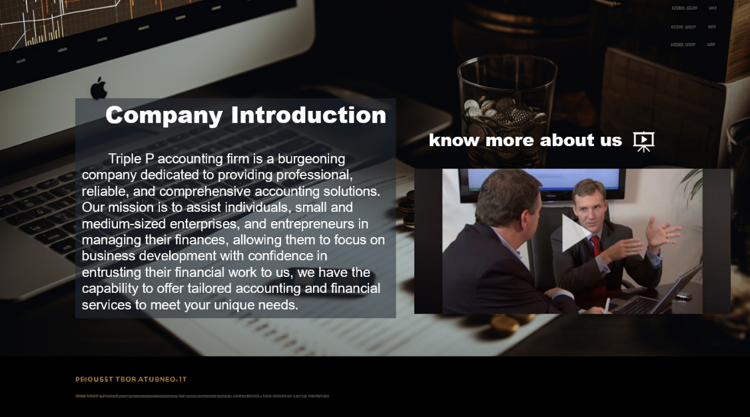
• Content
Highlights
Our website uses clear headings, bullet points, and concise paragraphs to organize information for easy reading and understanding.
Meaningful
Our website provides valuable and relevant information carefully tailored to meet our users' needs and interests, be it articles, product descriptions.
Up-to-Date
We keep our website's content current and relevant by regularly reviewing and updating it to ensure accuracy and timeliness.

Slide 36
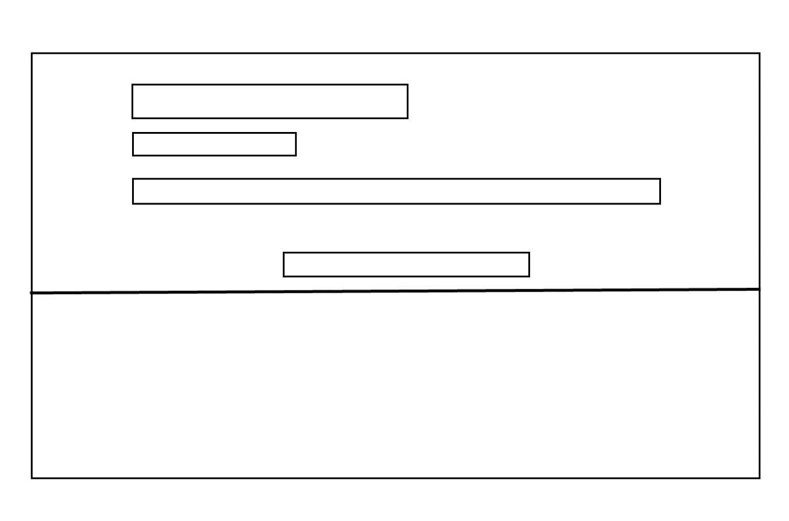
• Page Design Ideas
company name
slogan
navigation
background picture 1
slogan
background picture 2
1.Two high-definition images serve as the overall background.
2.The upper half of the homepage consists of a navigation bar.
3.In the top left corner of the navigation bar, the company name and slogan are displayed.
4.Clicking on hyperlinks within the navigation bar will present users with more detailed information they wish to browse.
5.The middle section of the homepage showcases the company's objectives.

Slide 37

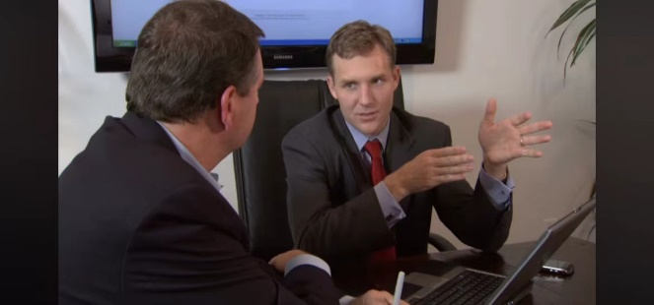
Company Introduction
Triple P accounting firm is a burgeoning company dedicated to providing professional, reliable, and comprehensive accounting solutions. Our mission is to assist individuals, small and medium-sized enterprises, and entrepreneurs in managing their finances, allowing them to focus on business development with confidence in entrusting their financial work to us, we have the capability to offer tailored accounting and financial services to meet your unique needs.
know more about us
company introduction
video introduction
text
video
background picture
The company's introduction, where you can find a text description on the left and a video introduction on the right, providing a better way to promote the company to users.

Slide 38
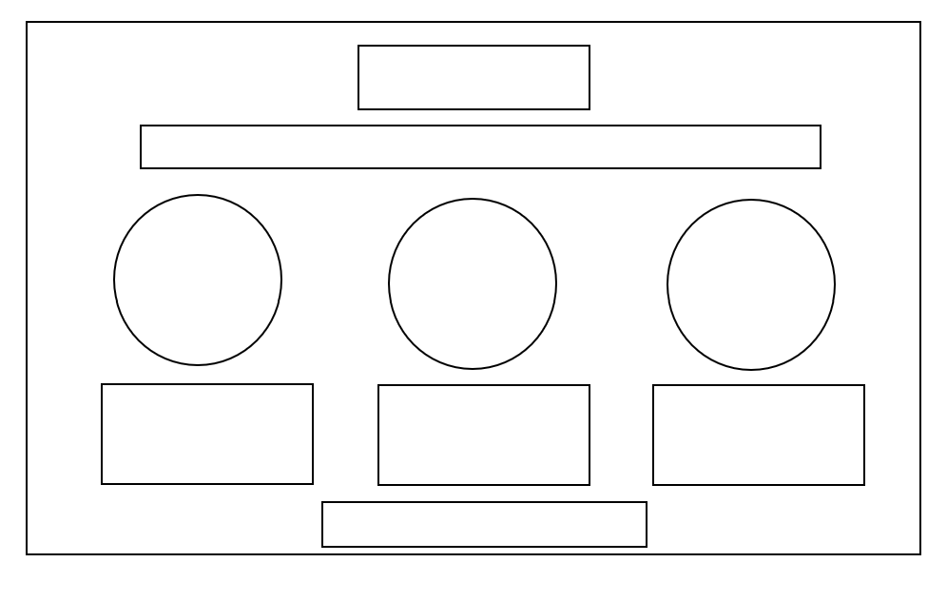





Our Team
title
These three founders are dedicated to providing excellent accounting and financial services.
brief introduction
image
image
image
Pirk
Picard
Paneway
Years of experience in accounting and financial management.
An expert in tax regulations and strategies.
Known for innovation and a focus on financial efficiency.
text
text
text
FOLLOW US !
background picture
icon
The introduction of the company's three founders, with detailed listings of their photos and professional fields. This is done to assist users in making more suitable choices and ultimately improving the quality of service.

Slide 39

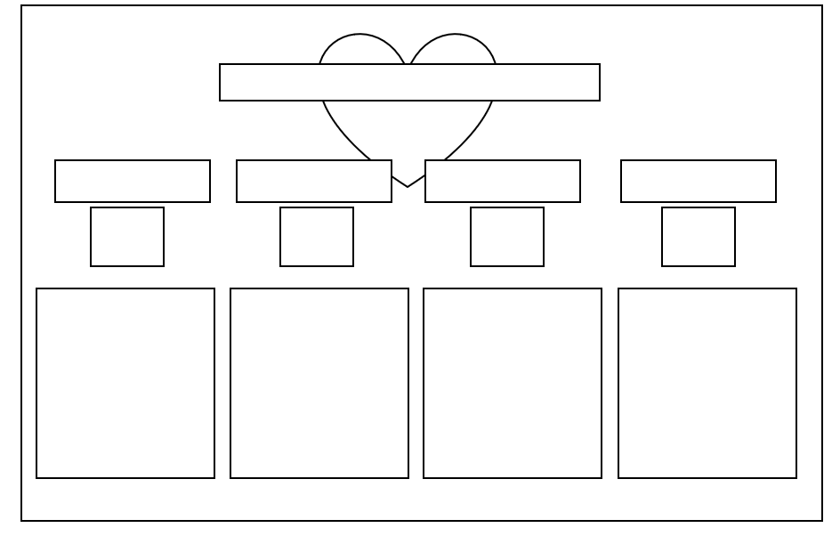
Enterprise Culture
title
Our Mission
Our Purpose
Our Guideline
Our Vision
image
subtitle
subtitle
subtitle
subtitle
Our mission is to provide exceptional accounting services to small businesses and empower their financial success through perfect tax accounting support.
Our purpose is to simplify financial management for small businesses by providing them with clear and practical solutions.
Our guideline is to prioritize interests of clients and uphold the values of integrity, precision, and efficiency.
Our vision is to create lasting value for our clients through outstanding service and innovative solutions.
icon
icon
icon
icon
text
text
text
text
background picture
This is enterprise culture section. Here, we separately showcase our company's mission, purpose, guidelines, and vision. This can deepen users' understanding of us and foster greater trust in the company.

Slide 40
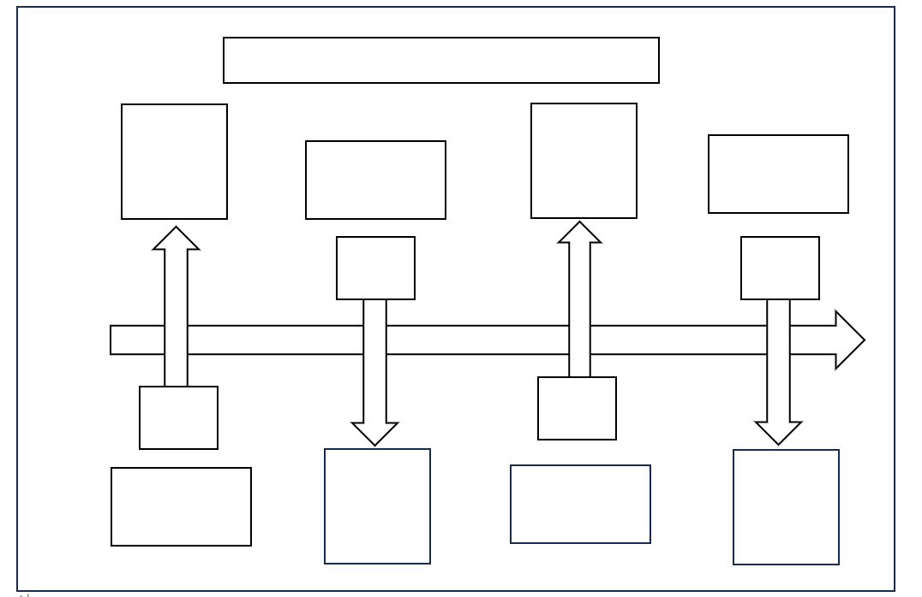
Future Development Timeline
title
Develop
Growth and consolidation
Leading
Innovation and sustainable
image
text
image
text
2
4
block
block
arrow
1
3
block
block
Start
Establishing a foundation
Accelerate
Expansion and absorption
text
image
text
image
The timeline for our company's future development, with three years as a milestone. We have outlined the development goals and directions for the company over the next 12 years. This can enhance the company's credibility.

Slide 41
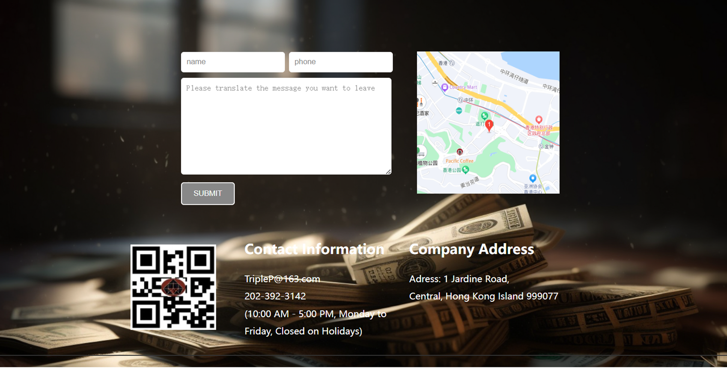
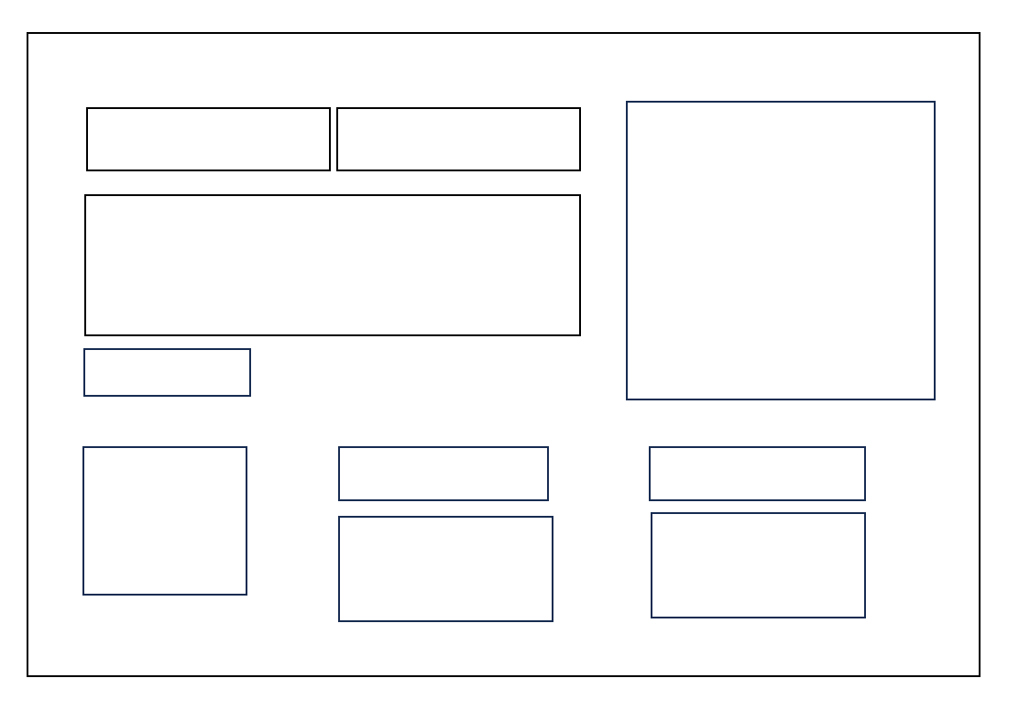
input
input
input
image
button
title
title
image
text
text
Footer section, which includes a message board for users to provide suggestions on our products and services. To the right of the message board, there is a location map indicating our company's position. Below that, you will find QR codes for our official WeChat accounts. In the lower right corner, you can find contact information such as email, phone numbers, and our physical address. All of this is designed to help users gain a clearer understanding of our company and facilitate effective communication with our personnel for any inquiries related to our business.

Slide 42
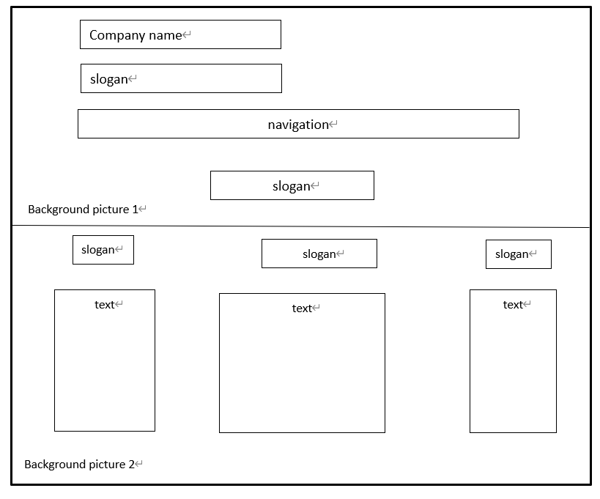
1.Clicking the hypeilink called INDUSTRY and then navigating to this page .
2.This page show the industries about this accounting firm .
3.A picture as the overall backround and there are 3 slogans that have their respective contents.
4.It provides customers with a better understanding of the company's offerings.

Slide 43
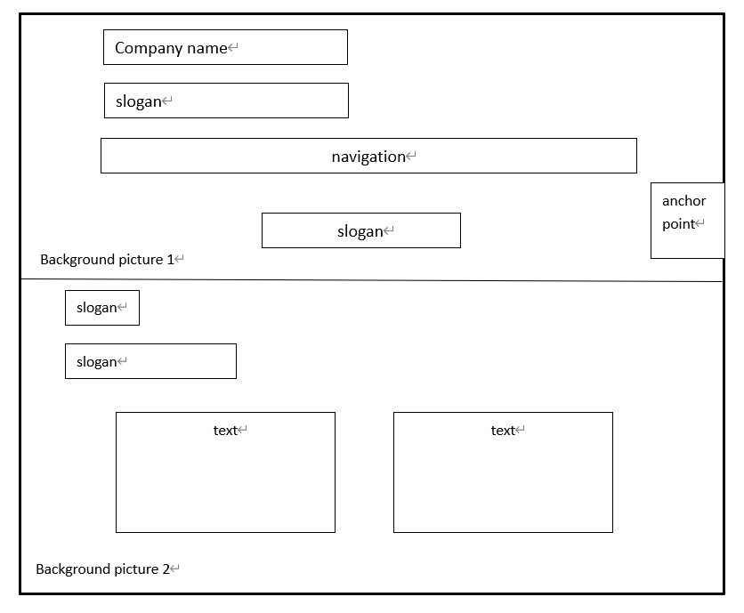
1.Clicking Services hyperlink, then navigating to this page.
2.This page about 4 services that this firm provide.
3.In the first service’s page, there are 2 slogans on the left, and two txt to describe this service. The only different of header is the addition of anchor point on the right.
4.This layout is more direction, brief . Anchor point makes people read different services content more quicklly.

Slide 44
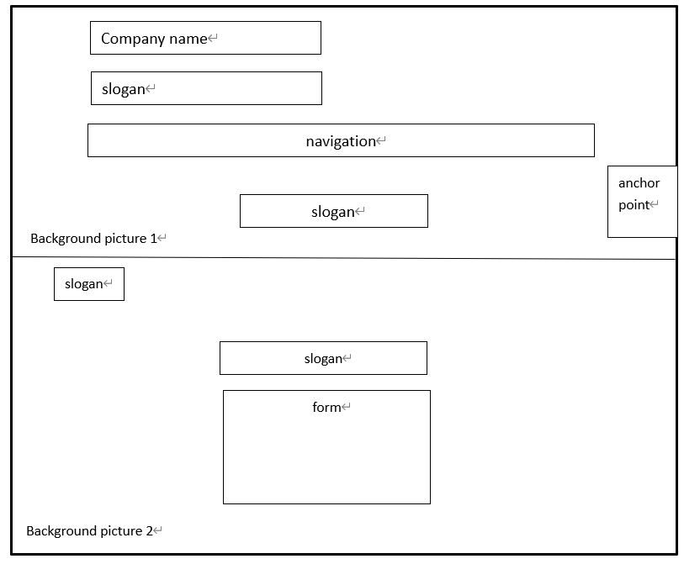
1.Clicking the anchor point and turing to next service.
2.One slogan on the left of the top, the other one in the center. And there is a form in the middle, readers can know the related information about this service directly.

Slide 45
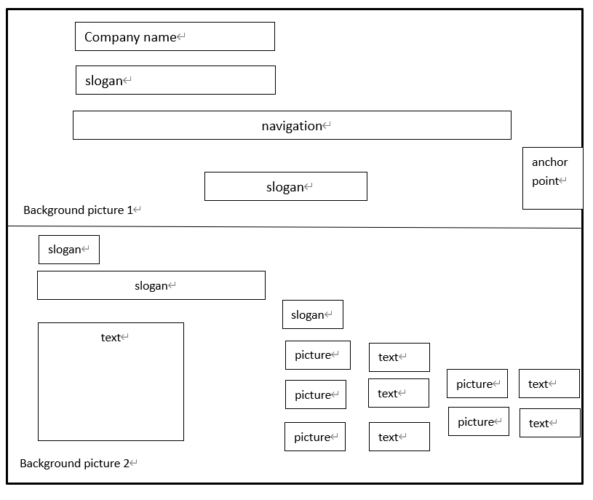
1.In this service’s page, there are two slogans and one text on the left.
2.On the right, the slogan lead readers to choose what content they want to know, and there are 5 texts that describe 5 aspects in this service.
3.These 5 images represent 5 different aspects or topics.

Slide 46
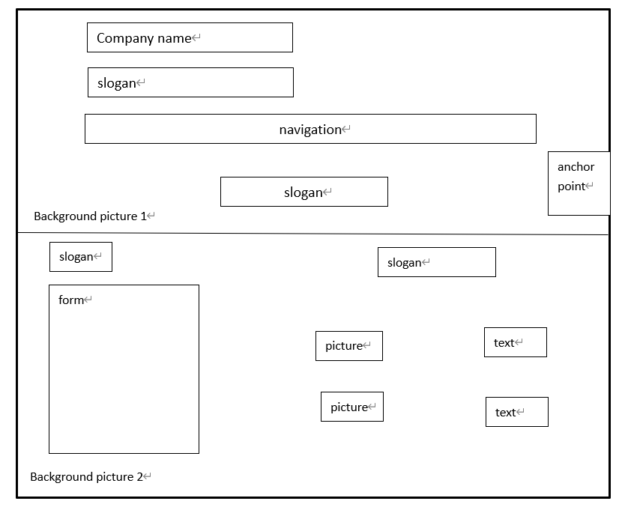
1.This page features two slogans, each located on opposite sides of the page.
2.The form on the right is describing the related content of this service. That is really directly and brief.
3.On the right, pictures along with their slogans represent the products that the company has developed in response to the particular service they offer.

Slide 47
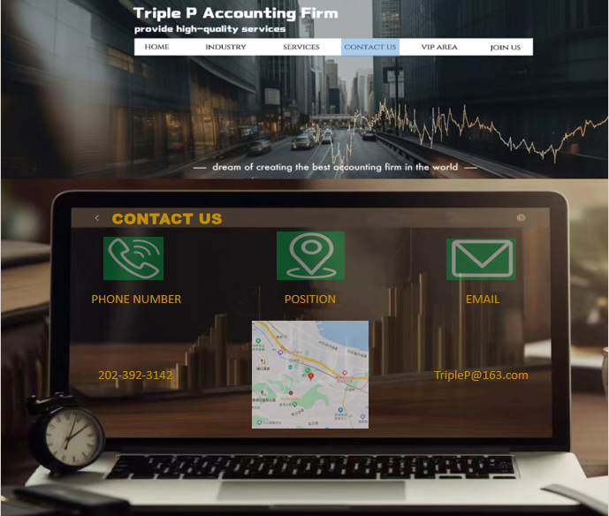
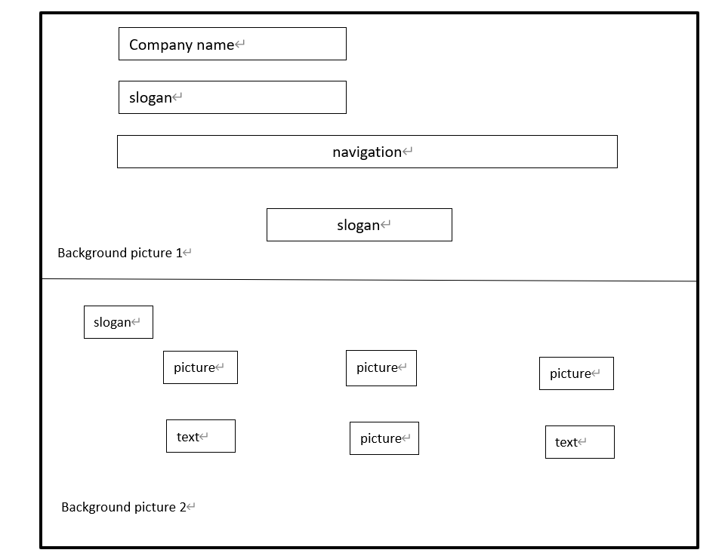
1.This page show how to contact this firm.
2.There are one slogan to describe the page called contact us. The three images represent respectively a phone number, a geographical location, and an email address vividly. The three texts tell people how to contact this firm.
3.The most creative aspect should be the background image in the lower half. It's an image of a computer, and we happened to incorporate the contact information right into this computer.

Slide 48
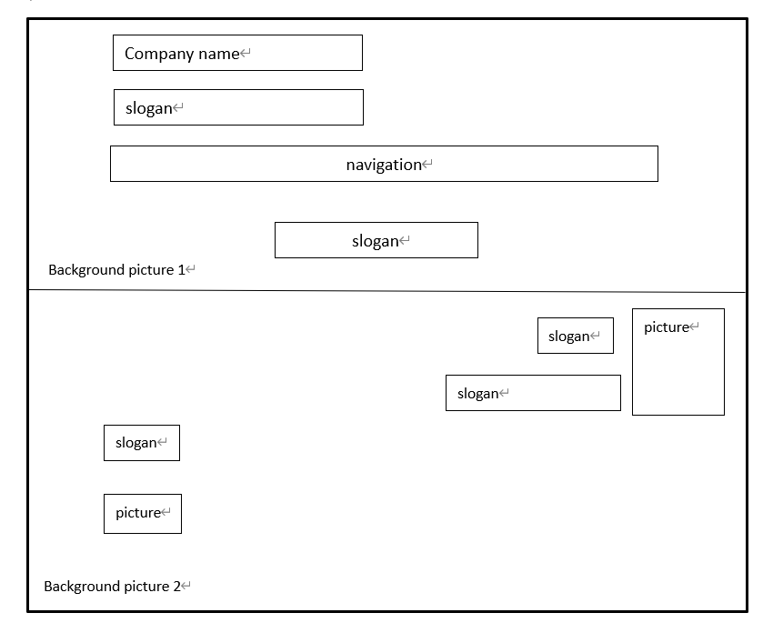
1.The slogan and image on the left side tell people that they should scan the QR code for online payments if they want to be VIP
2.The slogans on the right tell people the benefit to be a VIP.
3.The image on the right is a crown, representing the esteemed status of VIP customers.

Slide 49
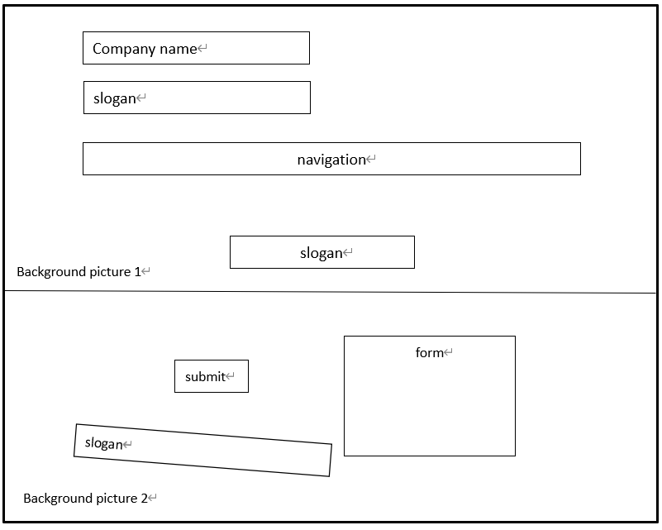
The form on the right is provided for job seekers who wish to join the company. After filling out the information above, they can click the "Submit" button in the middle of the page, and the company will receive the job seeker's information.

Slide 50

THANK YOU

